Slide 1
Hands On Intro to BioNetGen with VS Code Extension
Rule-Based Models

Slide 2

BioNetGen Resources Page

Slide 3
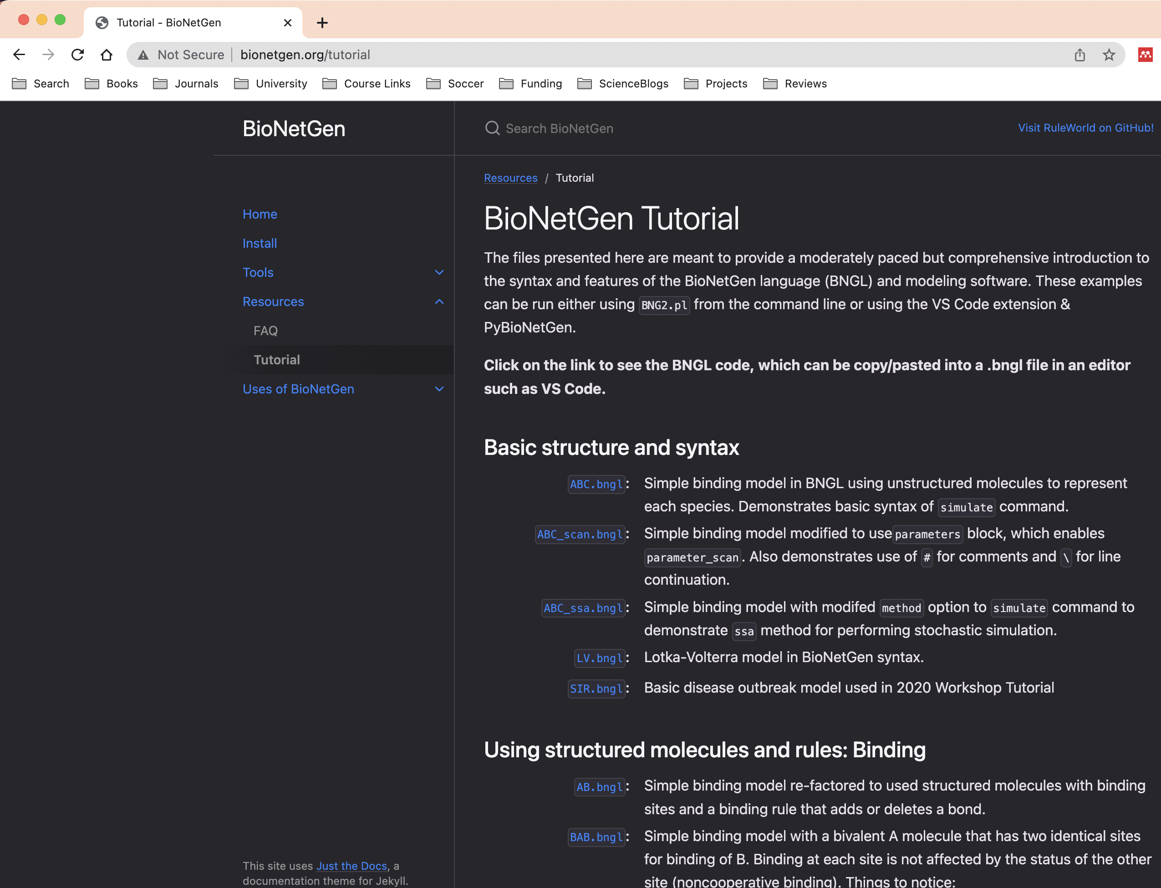
BioNetGen Tutorial
Gentle introduction to BioNetGen and rule-based modeling using examples.

Slide 4
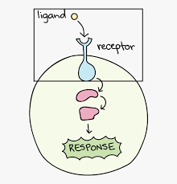
Setting up a simple model of ligand-receptor binding
BNGL
L(r)
R(l)

Slide 5
Molecule definitions go in the molecule types block
BNGL
begin molecule types
L(r)
R(l)
end molecule types

Slide 6
Constructing the ligand-receptor binding rule: reactants
begin reaction rules
L(r) + R(l)
end reaction rules

Slide 7
Constructing the ligand-receptor binding rule: arrow
begin reaction rules
L(r) + R(l) <->
end reaction rules

Slide 8
Constructing the ligand-receptor binding rule: products
begin reaction rules
L(r) + R(l) <-> L(r!1).R(l!1)
end reaction rules
‘!’ used to create bonds

Slide 9
Constructing the ligand-receptor binding rule: rate constants
begin reaction rules
L(r) + R(l) <-> L(r!1).R(l!1) kp1, km1
end reaction rules

Slide 10
Additional steps to complete the model
Define parameters kp1 and km1 (parameters block)
Set kp1=0.01 and km=1
Define species initially present (species block)
Take L0=R0=100
Define observables (observables block)
Free L and LR complexes
Add simulate action
What choice to make for t_end?

Slide 11
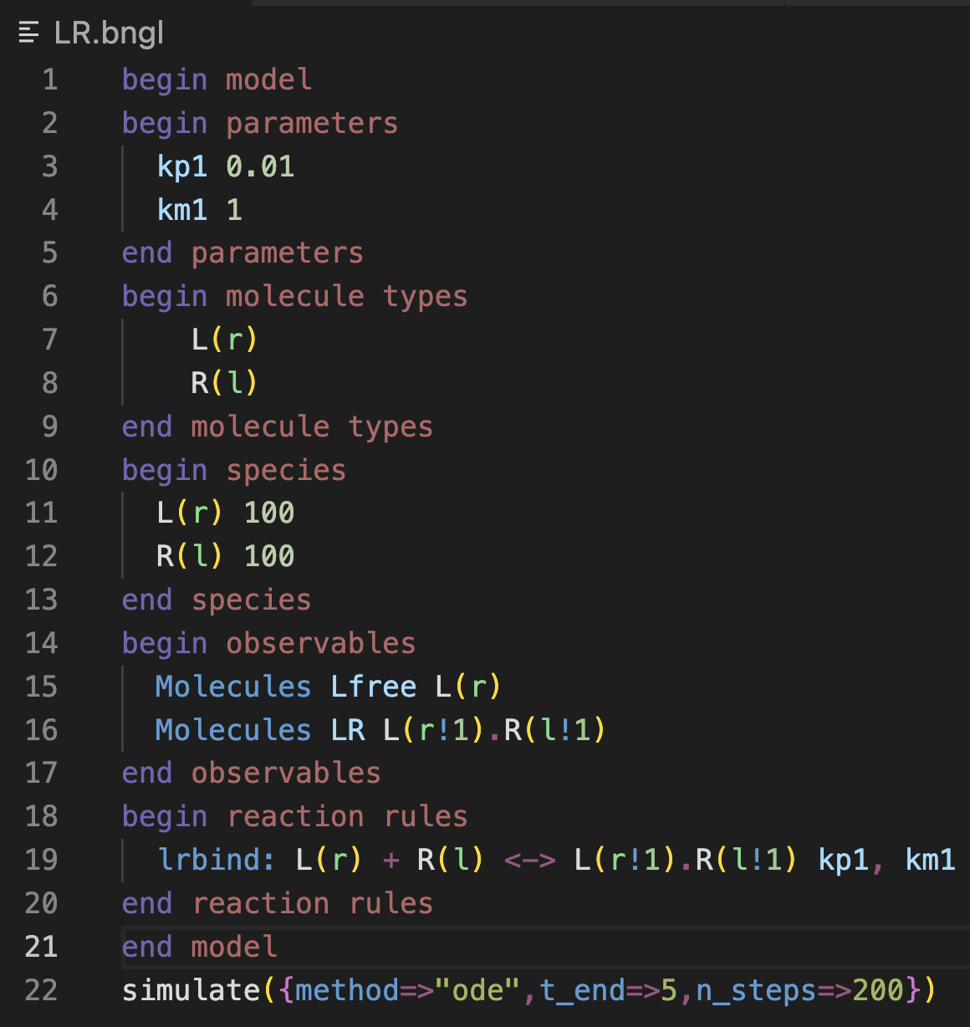
Complete model for reference

Slide 12
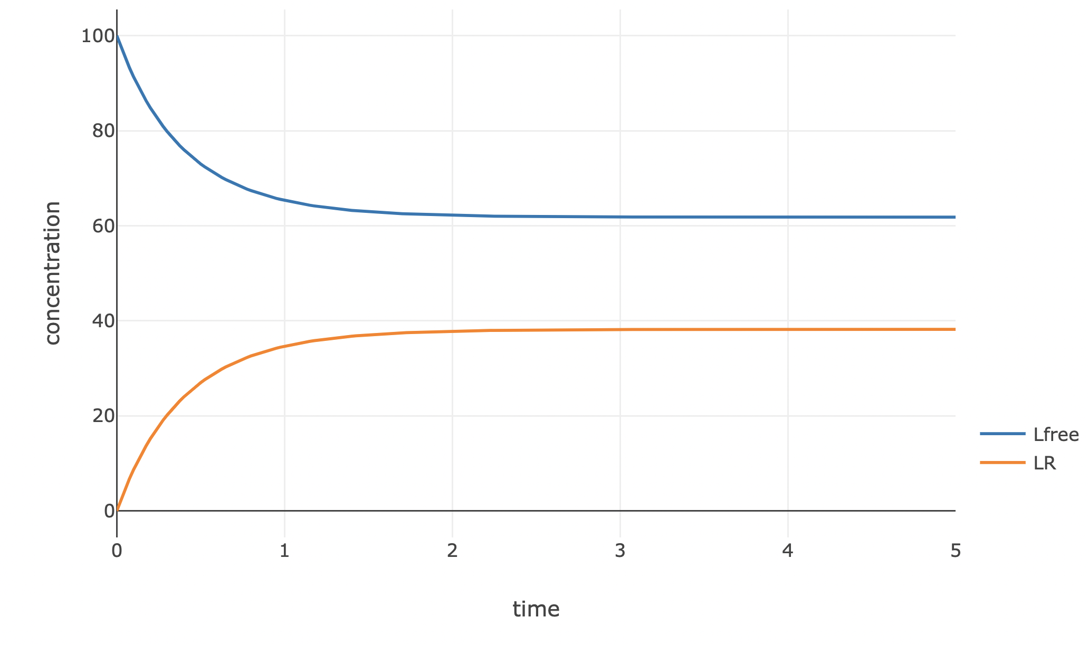
Time course for ligand-receptor model
Dark mode?

Slide 13
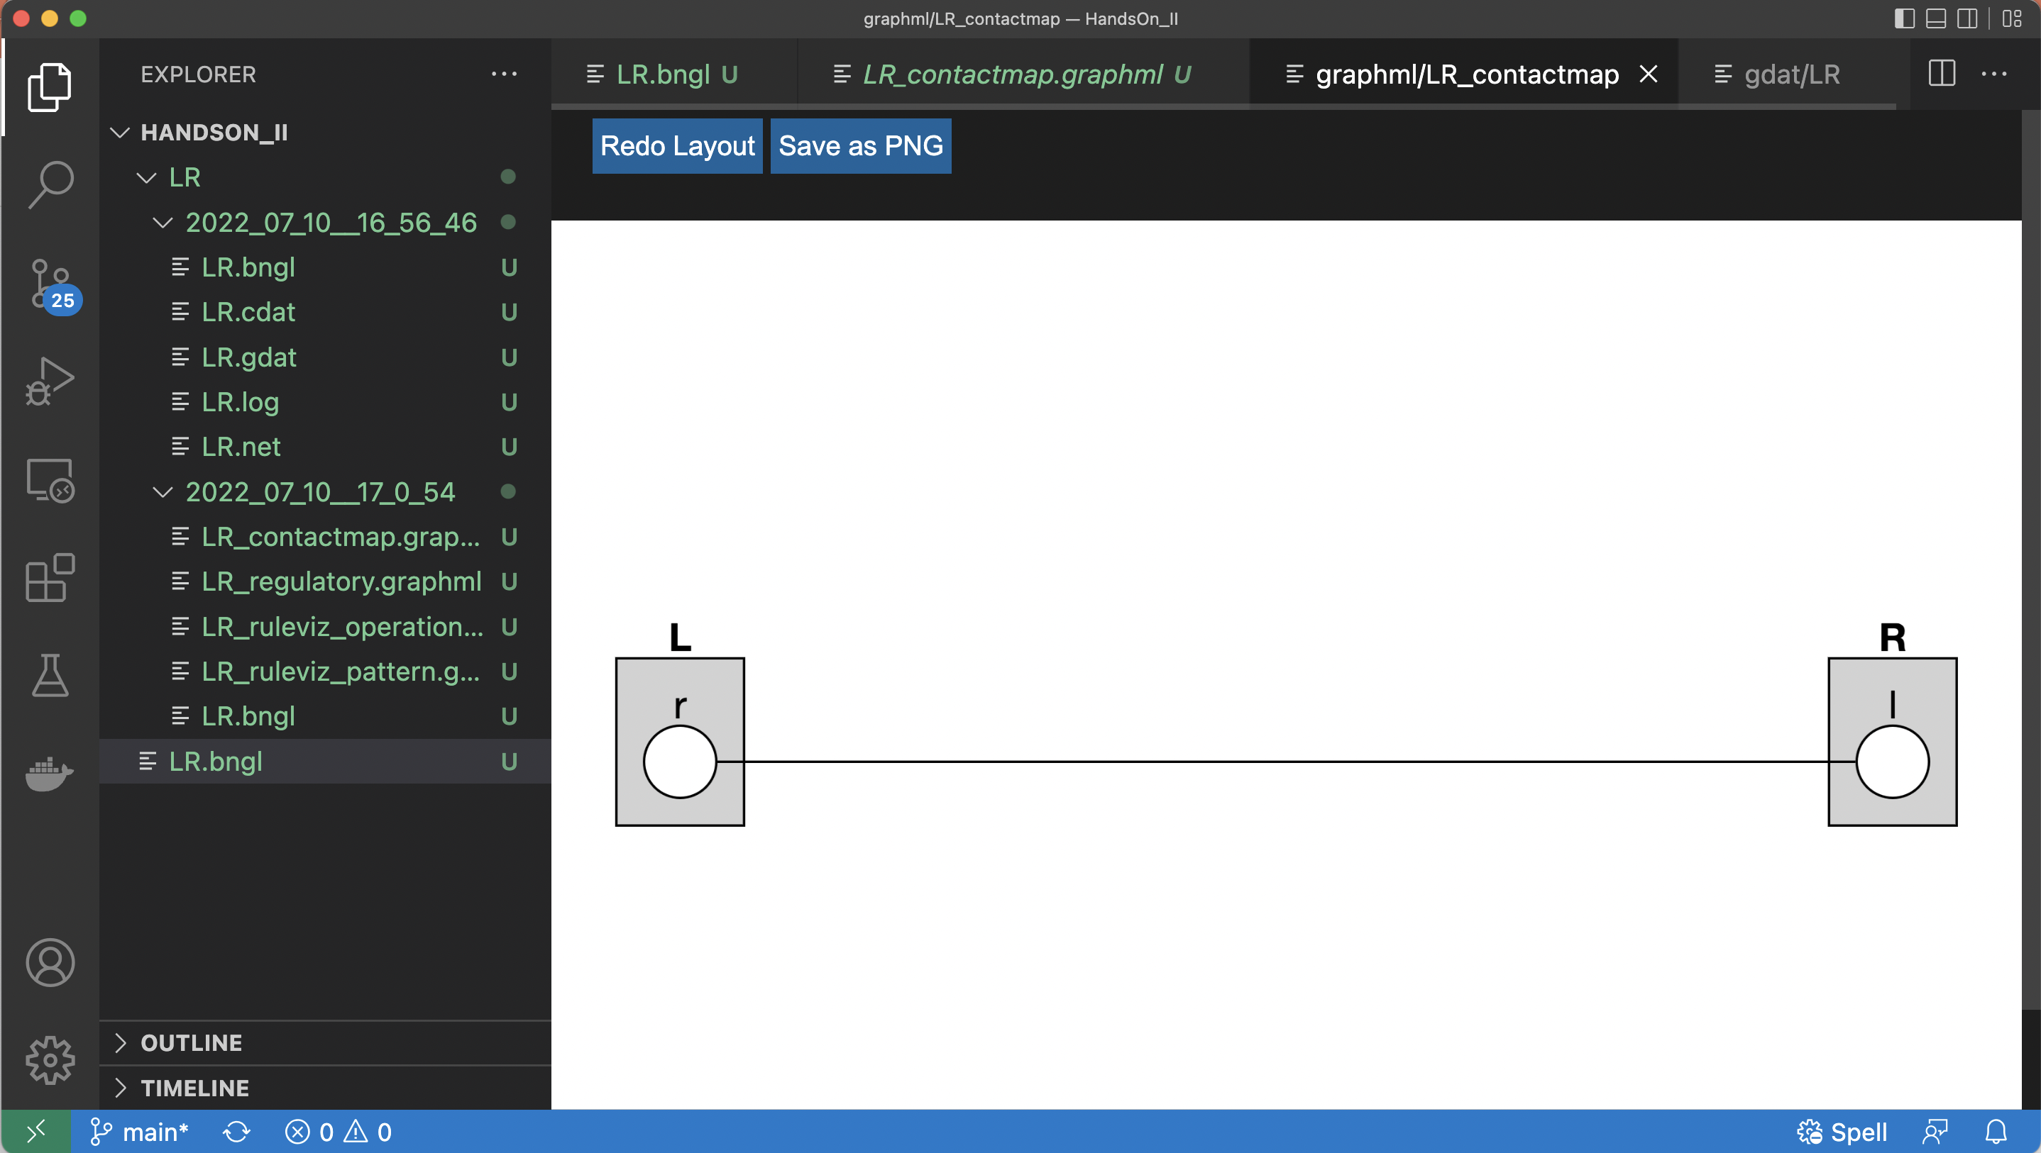
The “contact map” shows the molecules and interactions defined by the rules

Slide 14
Some finer points about “patterns”
Patterns are used to select sets of species with particular properties in observables and reaction rules.

Slide 15
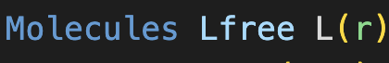
Some finer points about “patterns”
Patterns are used to select sets of species with particular properties in observables and reaction rules.
The ’r’ component of L is required to be unbound

Slide 16
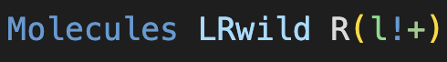
Some finer points about “patterns”
Patterns are used to select sets of species with particular properties in observables and reaction rules.
We can use the ‘+’ symbol to indicate that a bond must be present
The ’r’ component of L is required to be unbound

Slide 17
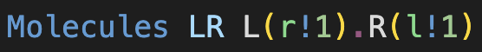
Some finer points about “patterns”
Patterns are used to select sets of species with particular properties in observables and reaction rules.
We can use the ‘+’ symbol to indicate that a bond must be present
is equivalent to
The ’r’ component of L is required to be unbound

Slide 18
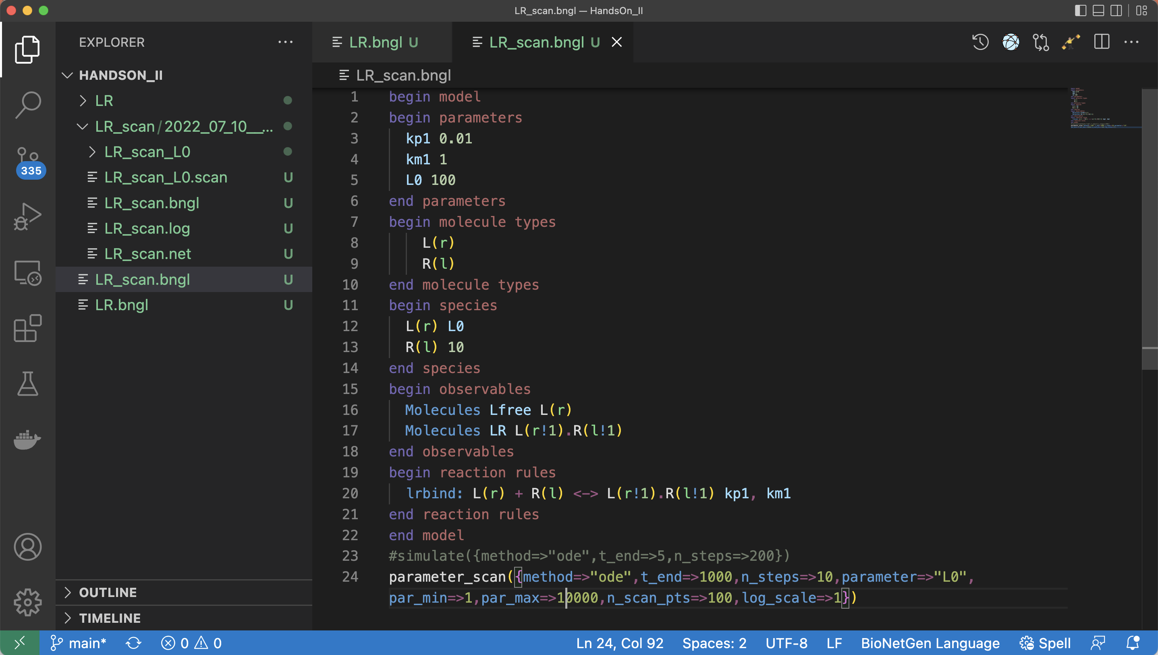
Using parameter_scan to study the effect of varying ligand concentration
Define initial ligand concentration using L0
Scan L0 over several orders of magnitude

Slide 19
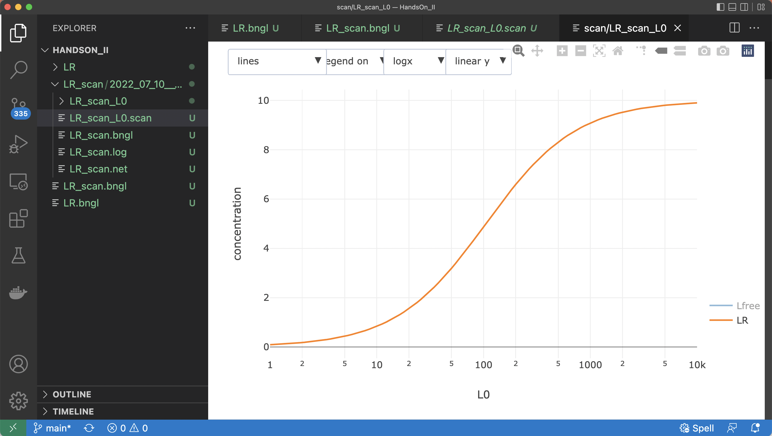
Using parameter_scan to study the effect of varying ligand concentration

Slide 20
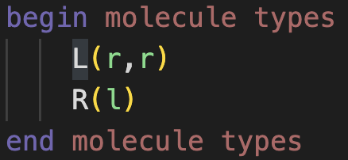
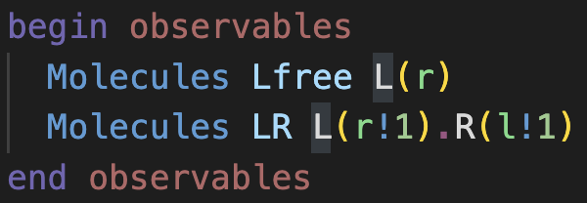
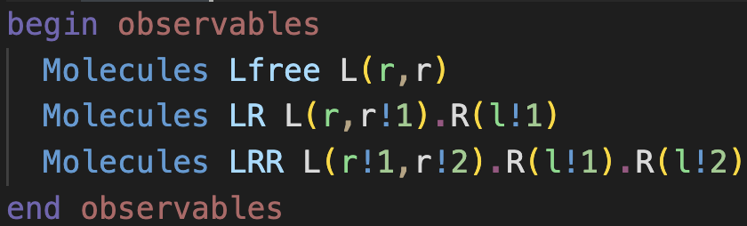
Let’s consider a bivalent ligand
Bivalent ligand has two equivalent sites for binding receptors
Modify observables

Slide 21
Let’s consider a bivalent ligand
Bivalent ligand has two equivalent sites for binding receptors
DON’T FORGET TO MODIFY THE SPECIES BLOCK TOO!
Modify observables

Slide 22
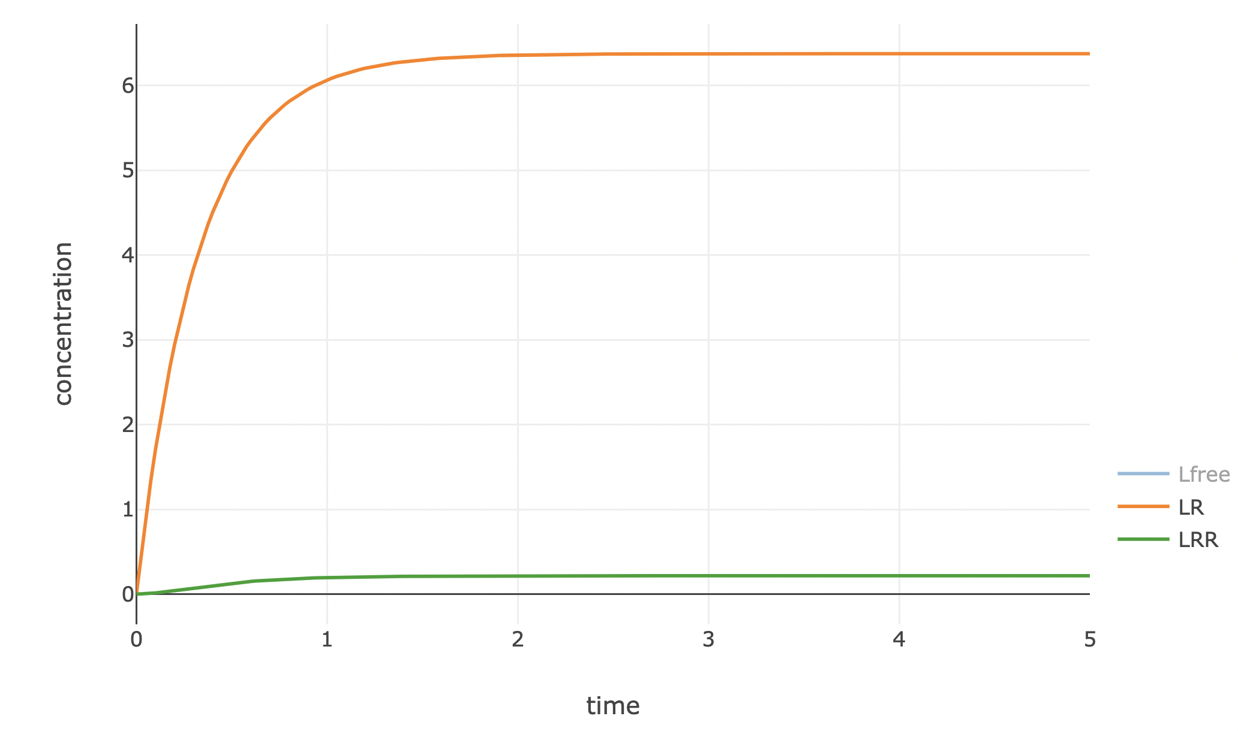
Timecourses for ligand binding and dimerization

Slide 23
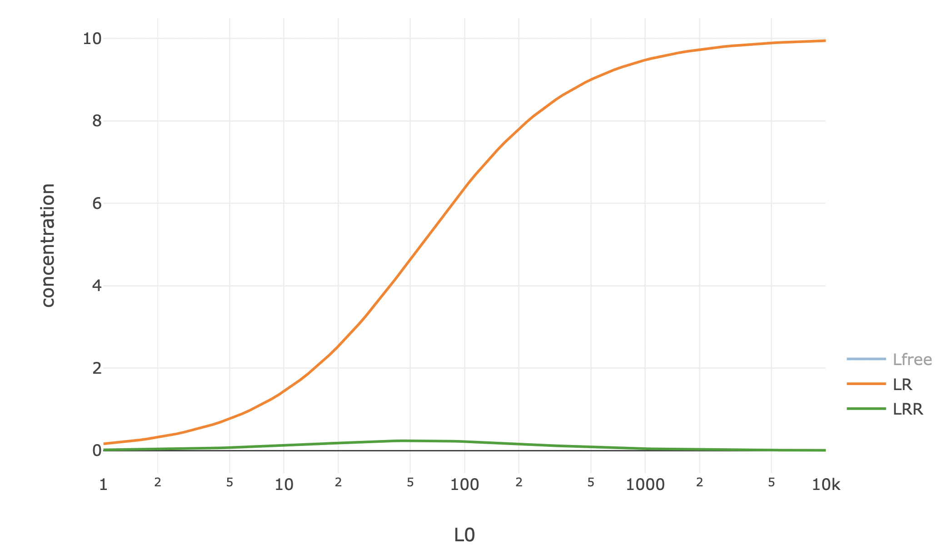
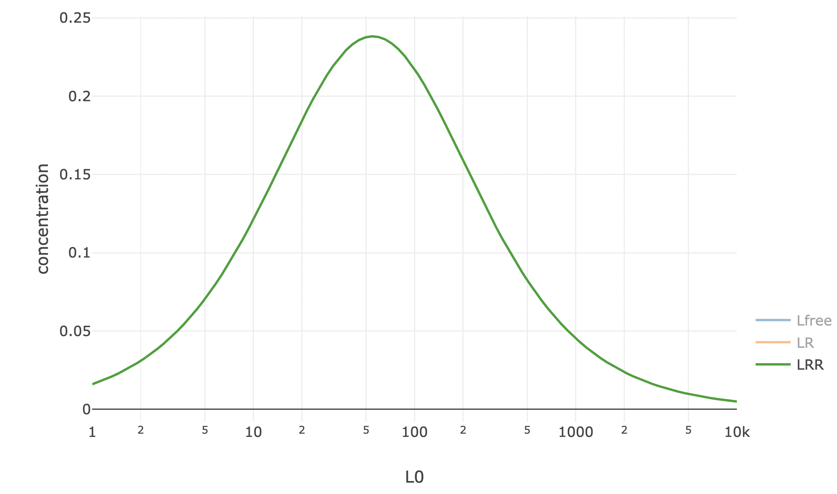
Parameter scan reveals possibly surprising result
Dimerization exhibits maximum at ~ 1/K_{d}

Slide 24
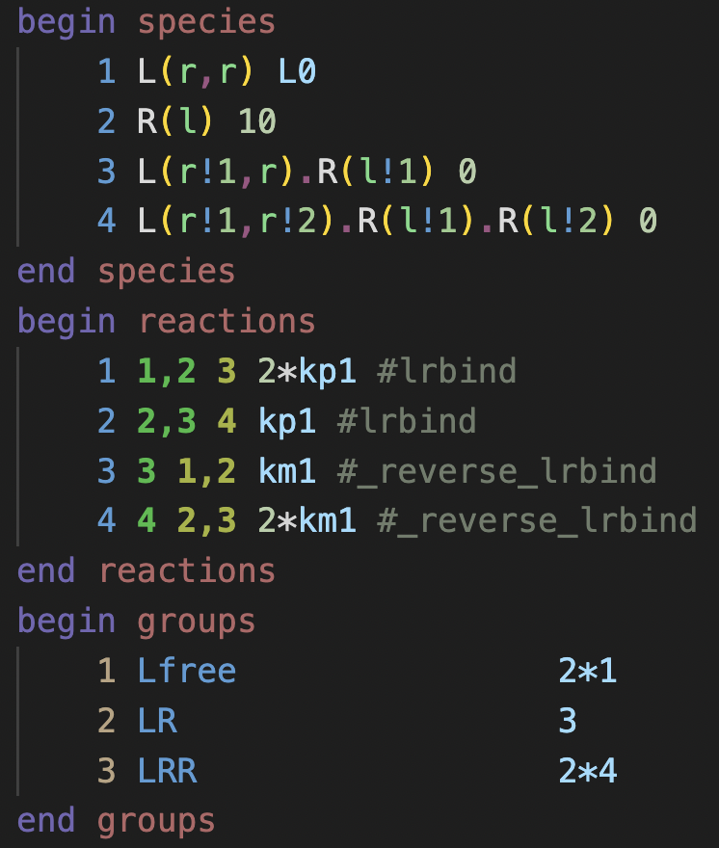
Examination of the .net file provides additional insights into the model
Two reactions are generated each by the forward binding rule (lrbind) and its reverse
In each case a factor of 2 is added to one of the reactions because of symmetry
Factors of 2 are also added to two of the observables (computed from groups) because of symmetry.
Species keyword can be used in observable definition to avoid these

Slide 25
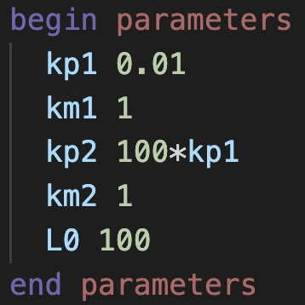
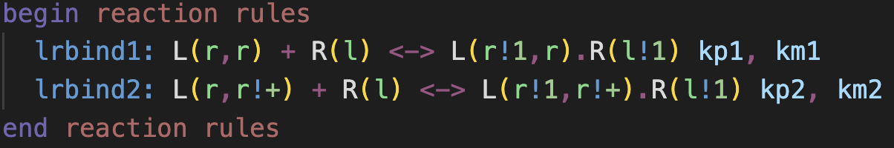
Exercise: How can we make the ligand binding cooperative?
kp1,km1
kp2,km2
What is the effect on the binding curve?

Slide 26
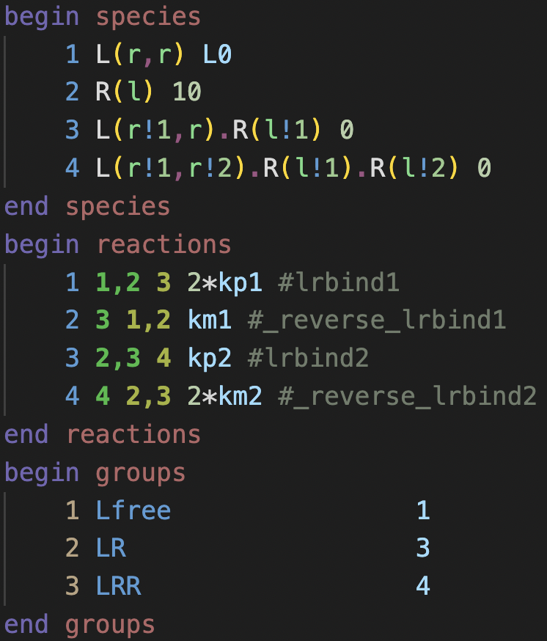
The .net file for modified model demonstrates expected network is generated
Original
Cooperative version

Slide 27
What happens if both ligand and receptor are bivalent?

Slide 28
What happens if both ligand and receptor are bivalent?
Network generation
Ad infinitum
This situation calls for network-free simulation

Slide 29
Modeling downstream events
A common scenario in cell signaling processes is receptor dimerization followed by receptor phosphorylation and recruitment of additional molecules

Slide 30
Modeling downstream events
A common scenario in cell signaling processes is receptor dimerization followed by receptor phosphorylation and recruitment of additional molecules
P

Slide 31
Modeling downstream events
A common scenario in cell signaling processes is receptor dimerization followed by receptor phosphorylation and recruitment of additional molecules
P

Slide 32


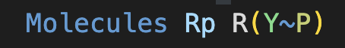
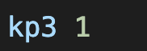
Defining a transphosphorylation rule
Modify molecule types
Modify species
Modify observables
Add reaction rule
Add new parameter(s)
kp3

Slide 33
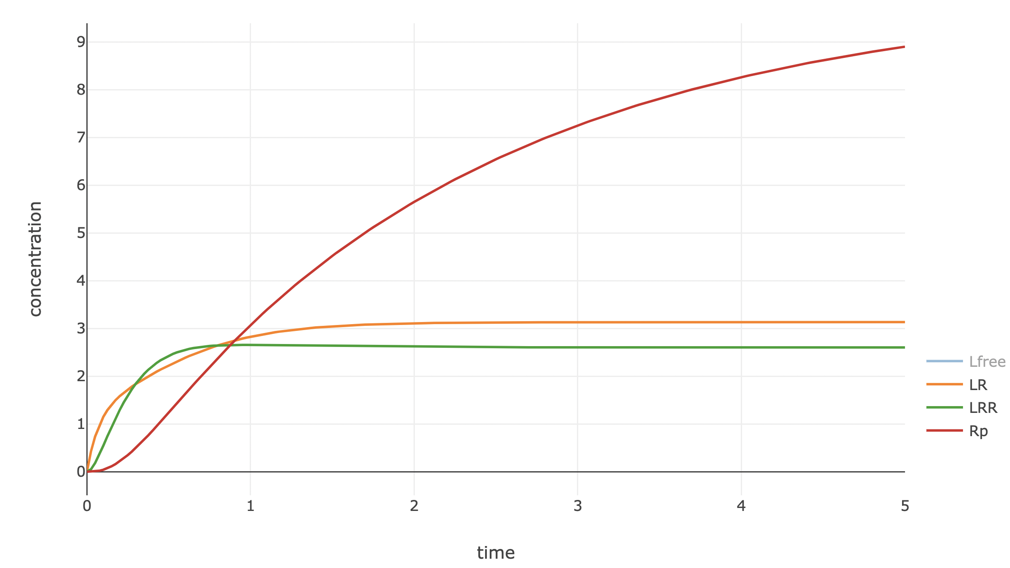
Without dephosphorylation, receptor phosphorylation quickly saturates

Slide 34
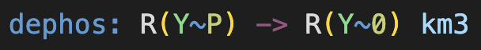
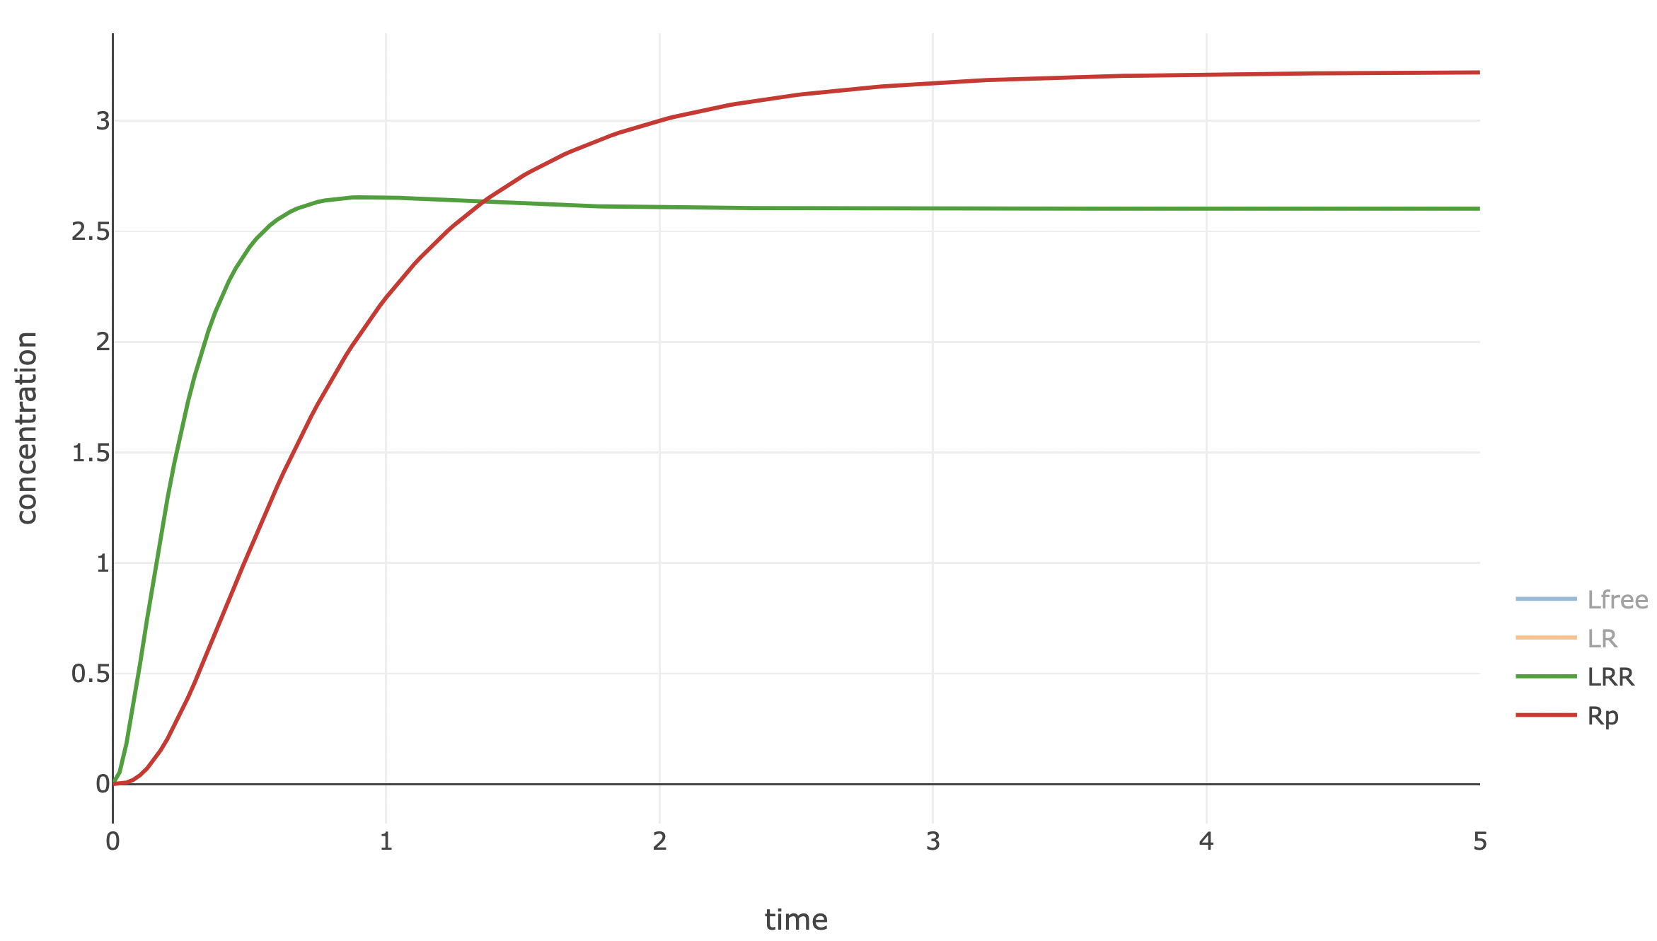
Dephosphorylation rule needed to prevent nonphysical saturation

Slide 35
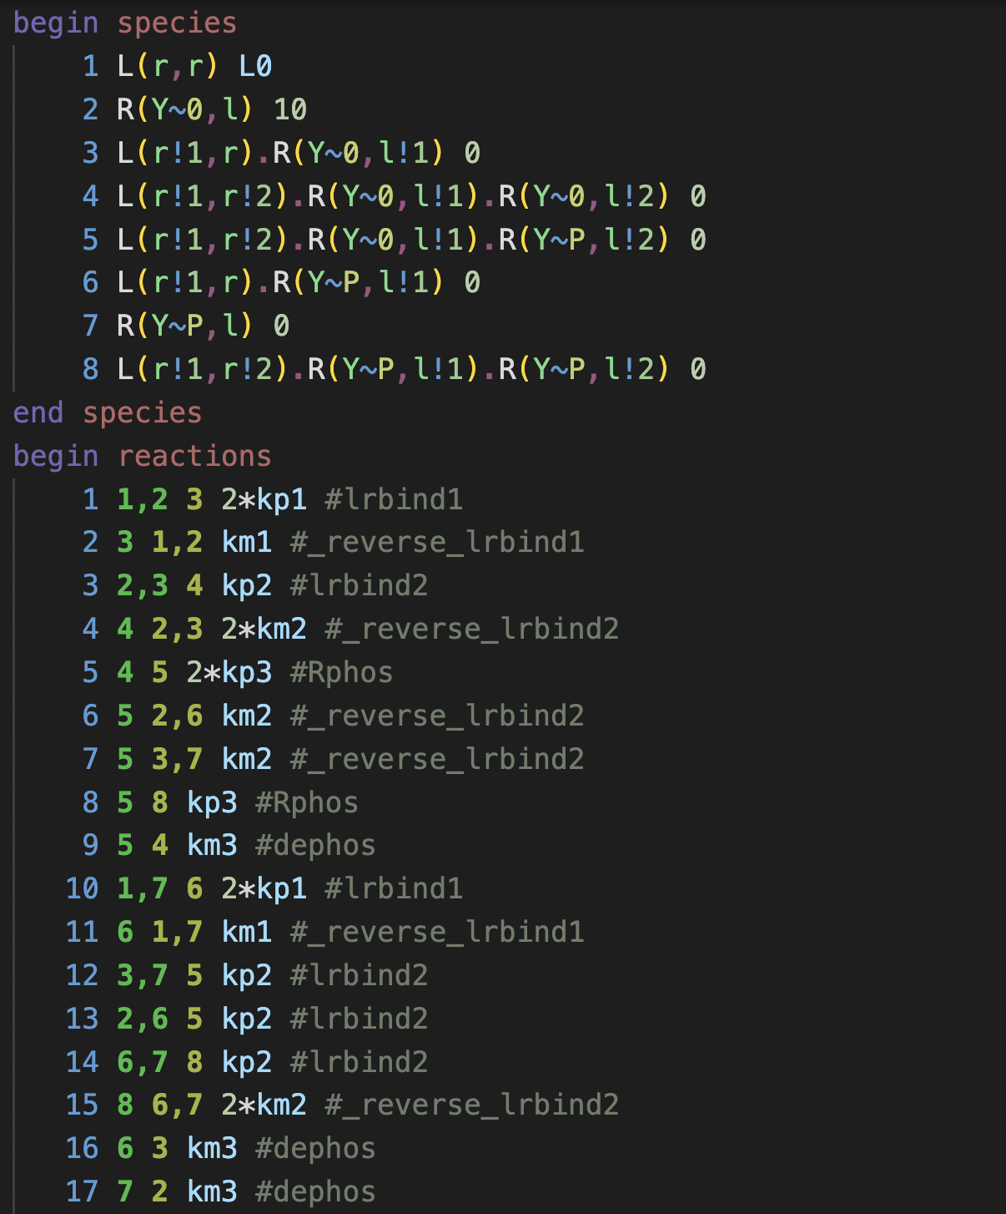
.net file reveals rapid expansion of the model upon addition of the phosphorylation site

Slide 36
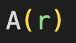
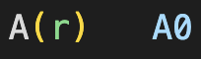
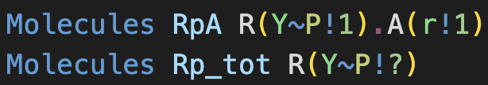
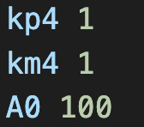
Adding adaptor binding
Modify molecule types
Modify species
Modify observables
Add reaction rule
Add new parameter(s)
kp4,km4

Slide 37
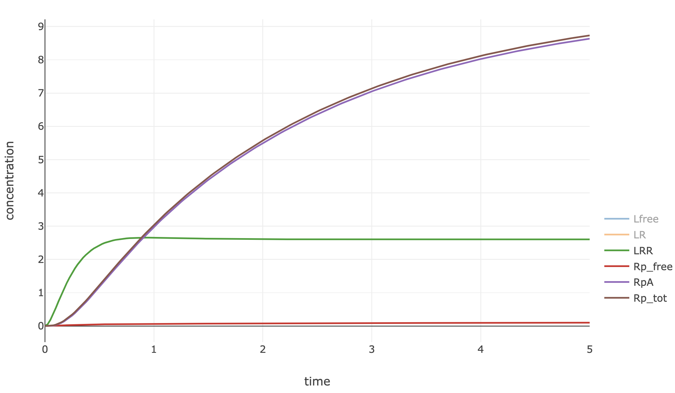
Adding adaptor restores saturation of receptor phosphorylation
Exercise:
Determine how steady state phosphorylation depends on ligand concentration.

Slide 38
Templates
Ligand
Receptor

